Slide 1
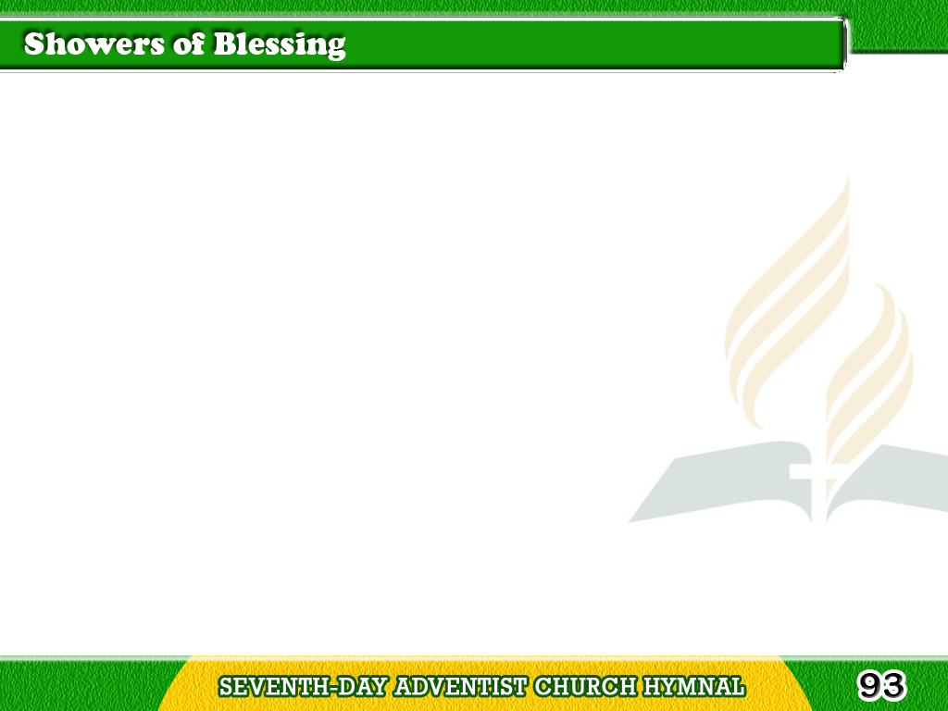
1/4
“There shall be showers
of blessing,”
This is the promise of love;
There shall be seasons refreshing,
Sent from the Saviour above.
Tagalog
Version

Slide 2
1/4
Chorus
Showers of blessing,
Showers of blessing we need;
Mercy drops round us are falling,
But for the showers we plead.
Tagalog
Version

Slide 3
2/4
“There shall be showers
of blessing”
Precious reviving again;
Over the hills and the valleys,
Sound of abundance of rain.
Tagalog
Version

Slide 4
2/4
Chorus
Showers of blessing,
Showers of blessing we need;
Mercy drops round us are falling,
But for the showers we plead.
Tagalog
Version

Slide 5
3/4
“There shall be showers
of blessing.”
Send them upon us, O Lord;
Grant to us now a refreshing;
Come, and now honor Thy word.
Tagalog
Version

Slide 6
3/4
Chorus
Showers of blessing,
Showers of blessing we need;
Mercy drops round us are falling,
But for the showers we plead.
Tagalog
Version

Slide 7
4/4
“There shall be showers
of blessing,”
O that today they might fall,
Now as to God we’re confessing,
Now as on Jesus we call!
Tagalog
Version

Slide 8
4/4
Chorus
Showers of blessing,
Showers of blessing we need;
Mercy drops round us are falling,
But for the showers we plead.
Tagalog
Version

